Slide 1
TECHNOLOGY TO BUILD COLLECTIVES
Presented By - Om Prakash (2019MCS2567)

Slide 2
2
1. AMAZON MECHANICAL TURK

Slide 3
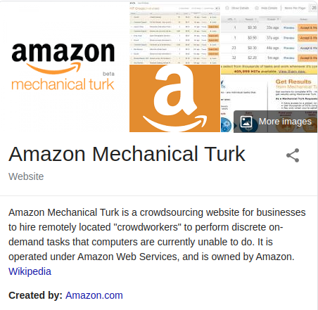
AMAZON MECHANICAL TURK
3
It is a website and service operated by Amazon
A meeting place for requesters with large volumes of micro-tasks and workers who want to do those tasks
Workers do work and get money in return
Business are known as requesters and Crowdworkers are known as Turkers

Slide 4
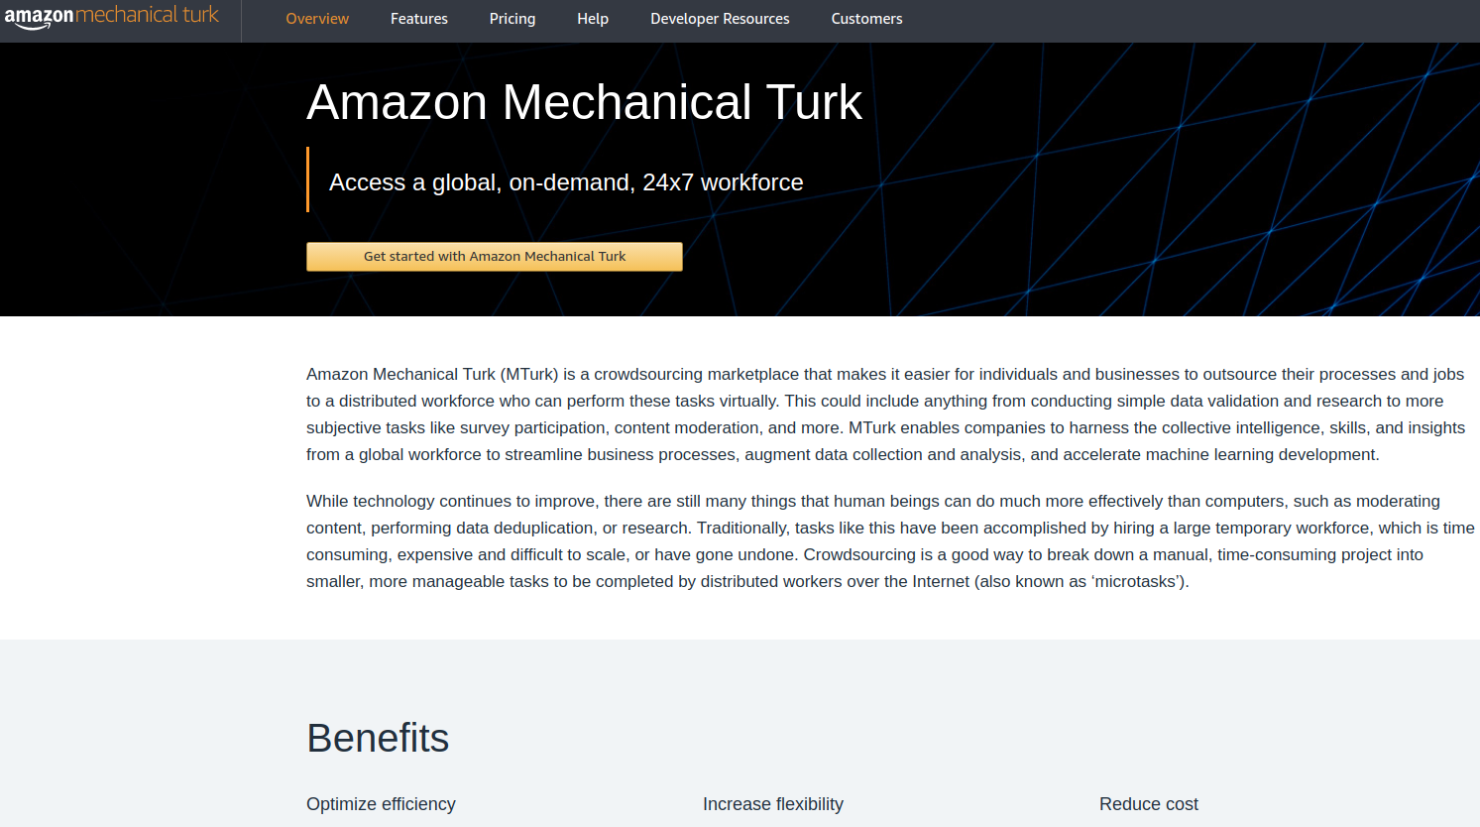
4

Slide 5
5
AMAZON MECHANICAL TURK Ctd..
Employers post jobs known as Human Intelligence Tasks (HITs)
Crowdworkers perform on-demand tasks that computers are currently unable to do
Such as identifying specific content in an image or video, writing product descriptions, or answering questions etc.
Notes:
I am working

Slide 6
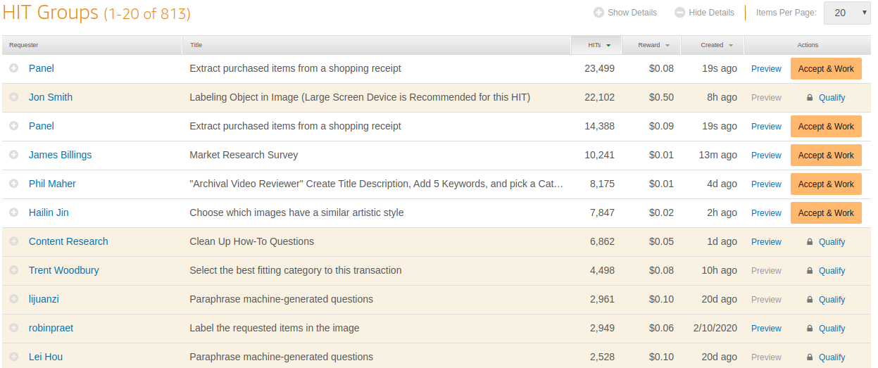
6
WORK DASHBOARD

Slide 7
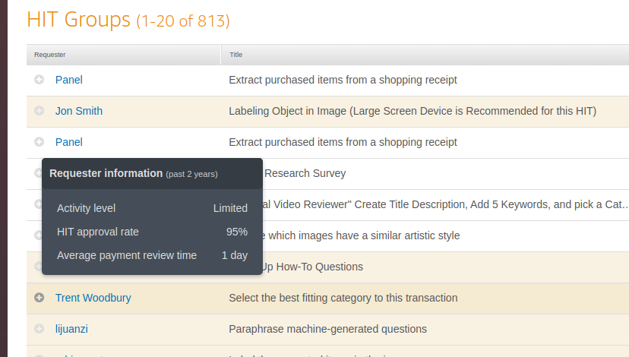
7
Rate of a HIT is set by an employer
A worker can see the preview of a requester information

Slide 8
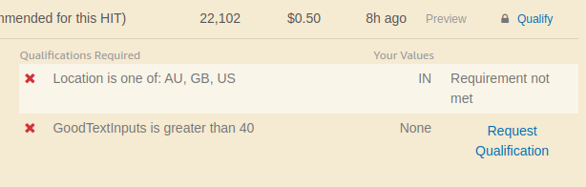
8
NOT QUALIFIED!
Qualify with a lock image shows
That requirements are not met
Details of the requirement not met
Requester has mentioned about the Location

Slide 9
9
QUALIFICATION REQUEST
A worker can request on a single click to a requester for a qualification.
It’s up to a requester to accept or reject a request.

Slide 10
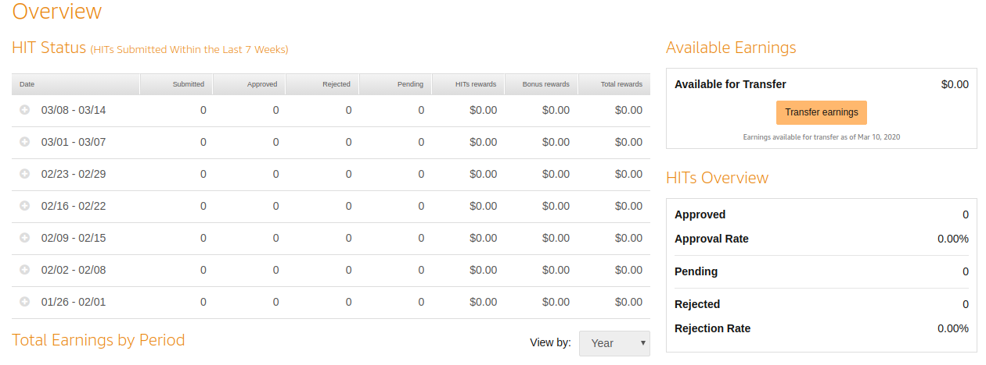
10
WORKERS DASHBOARD

Slide 11

11
WORK METHOD
Workers set their own hours and are not under any obligation to accept any particular task.
workers are paid as contractors rather than employees
So, workers don't have to file forms or pay payroll taxes
Workers must report their income as self-employment income

Slide 12

12
PAYMENT METHOD
Workers can have a postal address anywhere in the world
Payment for completing tasks can be redeemed on Amazon.com via gift certificate
Can later transferred to a Worker's U.S. bank account
Gift certificates are the only payment option available to international workers apart from India

Slide 13

13
QUALIFICATION TEST
Requesters can ask that Workers fulfill qualifications before engaging in a task
They can set up a test in order to verify the qualification
They can also accept or reject the result sent by the Worker
Acceptance/Rejection affects the Worker's reputation

Slide 14
14
EMPLOYERS ACCOUNT
When employers set up their job, they must specify
How much are they paying for each HIT accomplished
How many workers they want to work on each HIT
Maximum time a worker has to work on a single task
How much time the workers have to complete the work
Specific details about the job they want to be completed

Slide 15

15
LOCATIONS OF TURKERS
Workers have been primarily located in the United States since the platform's inception
In 2010, cash payments for Indian workers were introduced
In May 2015, it showed that 80% of workers were located in the United States, 20% elsewhere in the world and most of them were from India
In May 2019, It showed that 60% workers in US, and 40% elsewhere in the world and 30% are in India

Slide 16
16
2. MECHANICAL TURK USES

Slide 17
17
HUMAN-SUBJECT RESEARCH
Overall, the U.S. MTurk population is mostly female and white, and is somewhat younger and more educated than the U.S. population overall
Data collected on jobs conducted since 2013 show that the U.S. population is no longer predominantly female
The cost of MTurk was considerably lower than other means of conducting surveys
Thousands of papers that rely on data collected from Mechanical Turk workers are published each year
Researchers generally found that while samples of respondents obtained through Mechanical Turk do not perfectly match all relevant characteristics of the U.S. population
They're not wildly misrepresentative either

Slide 18

18
MACHINE LEARNING
Supervised Machine Learning algorithms require large amounts of human-annotated data to be trained successfully
ML Researchers have hired Workers through Mechanical Turk to produce datasets

Slide 19

19
MISSING PERSON SEARCH
Since 2007, the service has been used to search for prominent missing individuals
Satellite data was divided into 85 squared meter sections
MTurk users were asked to flag images that might be a crash site or other evidence that should be examined more closely
This search was unsuccessful

Slide 20
20
3. ETHICAL ISSUES

Slide 21
21
RESEARCH VALIDITY
The validity of research conducted with the Mechanical Turk worker pool has been questioned
Due to the proprietary method that Mechanical Turk uses to select its workers
The method of selection is not shared with researchers
Researchers can not know the true demographics of the pool of participants
It is unclear whether Mechanical Turk uses fiscal, political, or educational limiters in their selection process

Slide 22
22
LABOR ISSUES
Widely criticized for its interactions with and use of labour
Computer scientist Jaron Lanier notes how the design of Mechanical Turk "allows you to think of the people as software components“
You can just pluck results out of the cloud at an incredibly low cost
While a survey done by researchers at the University of Texas, showed that the surveyed Workers were motivated by enjoyment and self-fulfillment
These results may have been prejudiced by MTurk's Worker selection algorithms
A few Research study found that a quarter of online "gig workers" like those who work on Mechanical Turk do so because there are limited employment opportunities where they live

Slide 23
23
MONETARY COMPENSATION
Tasks are typically simple and repetitive and users are paid often only a few cents to complete them
Some have criticized MTurk for exploiting and not compensating workers for the true value of the task they complete
The minimum payment that Amazon allows for a task is one cent.
A lack of other opportunities, many workers accept the low compensation for the completion of tasks.

Slide 24
24
MONETARY COMPENSATION Cntd..
A study of 3.8 million tasks completed by 2,767 workers on Amazon's Mechanical Turk showed that "workers earned a median hourly wage of about $2 an hour
With 4 percent of workers earning more than $7.25 per hour
Workers are independent contractors, Hence, not protected by the Fair Labor Standards Act that guarantees minimum wage
By 2018, the increasing number of workers competing on the site reduced the total amount of work available
Workers do not receive additional compensation if a task takes longer than estimated by the requester
Hence, workers are forced to work for less in comparison to the normal rate

Slide 25
25
FRAUD CASES
The Nation magazine said in 2014 that some Requesters had taken advantage of Workers by having them do the tasks
Then rejecting their submissions in order to avoid paying them
In the Facebook–Cambridge Analytica data scandal, Mechanical Turk was one of the means of covertly gathering private information for a massive database
The system paid persons a dollar or two to install a Facebook connected app and answer personal questions
The survey task, as a work for hire, was not used for a demographic or psychological research project as it might have seemed
The purpose was instead to bait the worker to reveal personal information about the worker's identity

Slide 26
26
LABOR RELATIONS
The marketplace does not have the ability for the workers to negotiate with the employers
In response to the growing criticisms of payment evasion and lack of representation, a group has developed a third party platform
which allows workers to give feedback on their employers allowing other users to avoid potentially shady jobs and to recommend superior employers
Dynamo was created to allow the workers to collect anonymously and organize campaigns to better their work environment

Slide 27
27
LABOR RELATIONS Cntd..
Amazon has made it harder for workers to enroll in Dynamo by closing the request account that provided workers with a required code for Dynamo membership
Amazon has installed updates that prevent plugins that identify high quality human intelligence tasks
Additionally, there have been worker complaints that Amazon's payment system will on occasion stop working - a major issue for workers requiring daily payments

Slide 28
28
4. TURKOPTICON
– AN ACTIVIST TOOL

Slide 29
29
BILL OF RIGHTS
Turkopticon came out of engagements with “Turkers” in 2008
It invited workers to imagine what “better” crowdwork might mean
Responses to the survey were diverse and even conflicting
The following eight themes recurred
Uncertainty about payment
Unaccountable and seemingly arbitrary rejections
Fraudulent tasks
Prohibitive time limits
Pay delays
Uncommunicative
Requesters and administrators
Costs of employer errors borne by workers
Low pay

Slide 30
30
COLLECTIVES IN AMT
Turkers operate a variety of forums, employer review sites, and job sharing platforms
Workers share advice with one another, negotiate norms of work, and struggle to establish more interactive and participatory relationships with employers
These collectives are sites where workers manage themselves and other workers, set norms, help employers, and sometimes coordinate work refusals
TurkerNation
MTurkGrind
Subreddits
Turkers operate the forums,fundraise hosting feeds, and moderate communities
Regulate conversations, recruit requesters into collaboration, and educate newcomers
and help in acute need

Slide 31
31
COLLECTIVES IN AMT Cntd.
Turkers help resolve breakdowns through their forums
Advise employers about flawed task designs or bugs
They devise tools, infrastructures, and social norms to make their work more to their liking
Supply chain production relies on the diversity of skill, labor, location and regulation
This approach requires things, critiques, and protests, but also experiments in more just ways of life that make justice

Slide 32
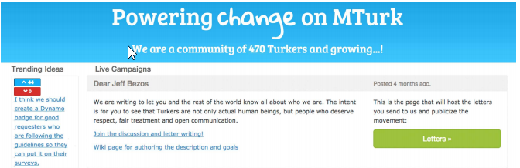
32
DYNAMO
Dynamo is a collective action platform for Amazon Mechanical Turk workers
A platform to support collective action in the AMT ecology. Dynamo around creating publics that are just large enough to take

Slide 33
33
CHALLENGES
AMT celebrated by media and business scholars as distributed networked production
That made new kinds of informational goods possible (e.g. Wikipedia and YouTube)
Challenges to collective voice and action were many
Different forums had different cultural ethos, forums sometimes splintered in the face of conflict
Workers frequently joined and left the AMT workforce
Few feared retribution from employers or from Amazon, including losing their AMT accounts
Difficult for workers to speak out about all but the most obvious shared issues without fear of frustration

Slide 34
34
5. COLLECTIVE / COOPERATIVE

Slide 35
35
Platform cooperativism proposes to create an alternative to the corporate sharing economy based on a model of democratically owned and governed co-operatives
Many platform co-operatives use business models similar to better-known apps or web services, but with a cooperative structure

Slide 36
36
6. COOPERATIVES

Slide 37
37
COOPERATIVE
Member-owned organizations, run and controlled for their members.
Members can be customers, employees, users or residents
To realize their common economic, social, and cultural needs and aspirations
Cooperatives are democratically managed
Bring people together in a democratic and equal way
Viewed as alternative to the dominant capitalist system (since early 1980s)

Slide 38
38
COOPERATIVES Cntd..
The cooperative was first born in 1844, during the transition to the industrial economy, through formation of a consumer cooperative focused on providing affordable food items.
The Rochdale Society established the principles of the cooperative movement, which today include
Open and voluntary membership
Democratic member control
member economic participation
autonomy and independence
A recent global survey suggests that there are as many as 2.6 million cooperatives with one billion memberships and clients

Slide 39
39
COOPERATIVES HIERARCHY
Every worker in a cooperative is also an owner
However, in some larger cooperatives, there exists a form of hierarchy
There is a president (elected by the workers), a board of directors (also elected), and so on
However, all major decisions are still made by votes taken in worker assemblies by 'one member, one vote' rule
The smaller the cooperative is the less formal its hierarchy will be - if it has one at all

Slide 40
40
DRIVEN BY VALUES
Businesses driven by values, and not just profit
Share internationally agreed principles & act together to build a better world
Putting fairness, equality and social justice at the heart of the enterprise
Allowing people to work together that generate long-term jobs and prosperity
Members share equal voting rights regardless of the amount of capital they put into the enterprises

Slide 41
41
COOPERATING TOWARDS ALTERNATIVES
Cooperative employment provides other benefits for flexible working, how being a member of a co-op was a safer choice in terms of social security benefits than becoming a founder of a limited company
co-op members could be classified as part-time entrepreneurs, a classification that would not disqualify them from unemployment benefits in the country
Each co-op is an experiment, that connects to the broader experiment of the cooperative movement, and highlights the inevitable highs and lows of cooperative organisations
Supportive networks are especially important for cooperatives since, individually, they may face particular trouble in securing capital, support, and advice

Slide 42
42
7. COOPERATIVES PRINCIPLES

Slide 43
43
COOPERATIVE PRINCIPLES
Voluntary and Open Membership
Open to all persons able to use their services
And willing to accept the responsibilities of membership
Without gender, social, racial, political or religious discrimination
Democratic Member Control
Democratic organizations controlled by their members
Participate in setting their policies and making decisions
Member Economic Participation
Members contribute equitably to the capital of their cooperative
Members usually receive limited compensation

Slide 44
44
COOPERATIVE PRINCIPLES Cntd.
Autonomy and Independence
Cooperatives are autonomous, self-help organizations controlled by their members
If they enter into agreements with other organizations
They do so on terms that ensure democratic control by their members
and maintain their cooperative autonomy
Education, Training, and Information
Cooperatives provide education and training for their members
So they can contribute effectively to the development of their co-operatives
They inform the general public particularly young people
And, opinion leaders about the nature and benefits of co-operation

Slide 45
45
COOPERATIVE PRINCIPLES Cntd.
Cooperation among Cooperatives
Cooperatives serve their members most effectively and strengthen the cooperative movement
By working together through local, national, regional and international structures
Concern for Community
Cooperatives work for the sustainable development
Of their communities through policies approved by their members

Slide 46
46
8. COLLECTIVE V/S COOPERATIVES

Slide 47
47
COLLECTIVE V/S CO-OPS
Decision Making
Most cooperatives require simple-majority to pass a vote. That is, only over 50% of
workers have to approve a motion for it to be passed
Collectives, however, use a consensus model that every worker must vote
“yes” in order to make a decision
Hierarchies
Both cooperatives and collectives reject the hierarchical structure of typical corporations
Every worker in a cooperative is also an owner
In some larger cooperatives, there exists a form of hierarchy
Collectives tend to strive to abolish any form of hierarchy
No worker in the collective has any more authority than another worker

Slide 48

48
MANAGEMENT
In a conventional company, managers carry out the will and the decisions of the owners
Larger cooperatives are more likely to employ managers than collectives because this is often viewed as a form of hierarchy
Collectives are much less likely to have managers, if they do, have rotating system

Slide 49
49
9. REASONS CO-OPS CAN FAIL

Slide 50
50
REASONS CO-OPS CAN FAIL Cntd.
Failure to incentivize shareholders
Participation in a co-operative often includes some investment of time and/or money
Shareholders typically see some form of benefit for themselves
Benefits may include a dividend, a patronage refund, access to a new product or service, greater market certainty
Failing to provide tangible incentives, will limit member applications and shareholder participation
Power becomes centralized
Co-operatives often have more inclusive governance structures
Strength of co-operatives is closely linked to their ability to listen to and serve their shareholders or members
When power and authority within a co-operative begins to centralize around a few individuals like boards or managers
Shareholders may feel disengaged or excluded from a business

Slide 51
51
REASONS CO-OPS CAN FAIL Cntd..
Wrong people in the wrong places
Co-operatives, like most businesses and organizations, rely on people working together towards a common goal to be successful
When directors or managers view the co-operative business model or co-operation with contempt, their decisions can undermine the co-operative’s ability to function
Shareholders also have a responsibility to hold leadership accountable when their actions undermine the co-operative’s goals
Not planning for succession
Co-operatives, like any other businesses and organizations, need to plan for their future
Leaders and managers will eventually retire or leave the co-operative, creating a need for someone new to fill the gap
Co-operatives need to actively recruit new members as older members leave to ensure their business has a sustainable, supportive base

Slide 52
52
REASONS CO-OPS CAN FAIL Cntd..
Lack of market or community support
Co-operatives work best when the idea and development of the business is led by the group that will be involved with the co-operative
This can create a sense of ownership and loyalty not commonly found in other business models
When a co-op is imposed by a group outside the community or market, this sense of ownership does not emerge organically

Slide 53
53
10. COLLECTIVE - BARGAINING

Slide 54
54
PLATFORM COOPERATIVISM
Platform cooperativism proposes the idea to cut out the corporate middleman and replace Uber with a service owned and managed by taxi drivers themselves
Create a version of Airbnb run by cities
Facebook into a platform democratically controlled by all users
Aims to foster social change by creating a People’s Internet and replacing corporate-owned platforms with user-owned cooperatives
Shaped by tensions and contradiction between politics and enterprise, democracy and the market, commons and commercialisation, activism and entrepreneurship

Slide 55
55
COLLECTIVE BARGAINING
The term ‘collective bargaining’ was first used in 1891 by Beatrice Webb, an economic theorist
Collective bargaining can be viewed as the most developed form of representative or collective voice, as it is typically carried out within a framework of rules, procedures, and rights set out in national and international law
Collective bargaining is a process of negotiation, joint decision-making, or joint regulation between groups who represent both employer and employee interests
It can involve the different actors the state, trade unions, works councils, employers, middle managers, and employees
Formal negotiations between two organizations representing employer and worker interests, and holding different forms of political and economic power

Slide 56
56
COLLECTIVE FOR ON-DEMAND WORKERS
Some just-in-time workers are attempting to address the problem of irregular and unpredictable hours through collective bargaining
Through collective bargaining, the workers achieved predictability in their schedules and plan their lives accordingly, limit on-call work, minimum-hours guarantee
Because of their uncertain status under the labour laws, it is unclear whether or not on-demand workers have a right to unionise
As independent contractors, any collective action they take to improve their wages could subject them to liability and substantial damages under the antitrust law
However, even in the uncertainty, some on-demand workers have been attempting to take collective action and form organizations to improve their working conditions

Slide 57
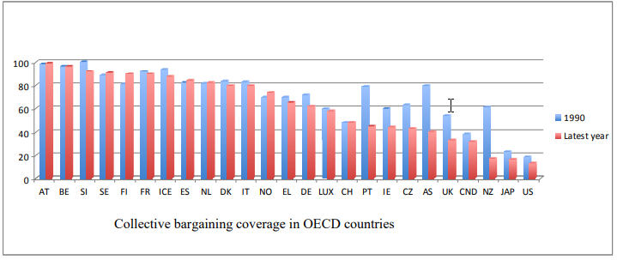
57
COLLECTIVE BARGAINING COVERAGE
For the OECD as a whole, over 60 percent of the workforce is covered by collective agreements
Coverage is over 70 percent in most of Western Europe – with over 90 percent coverage in Austria, Belgium, Sweden, Finland, and France

Slide 58
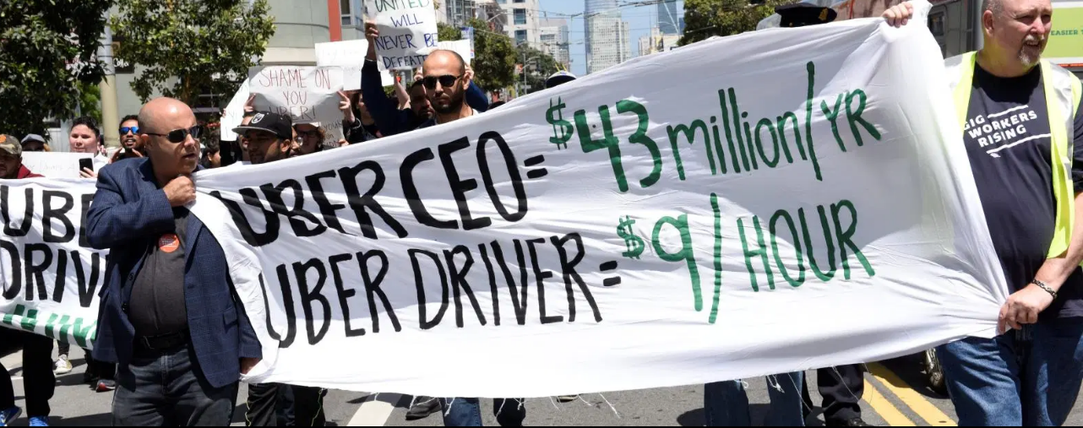
58
UBER DRIVERS GUILD
Uber drivers in New York city have formed the Independent Drivers Guild which meets regularly with Uber Management and seeks to advocates for the drivers over discipline and other complaints.

Slide 59
59
UBER DRIVERS COLLECTIVE
Other Uber drivers in New York have joined the rival New York Taxi Workers Alliance, an organization that offer services such as assistance with traffic citations, and lobbies the Taxi and Limousine Commission on behalf of drivers
In Settle, Uber drivers joined with local unions to press for a city Ordinance that would give them a right to representation
In December 2015, the city of Seattle enacted an Ordinance to permit for-hire-drivers to unionise and bargain collectively for driver compensation rates other terms of their contracts
Drivers can select an exclusive driver representative (EDR) who will be the sole for drivers operating in a city, called driver coordinator

Slide 60
60
UBER DRIVERS COLLECTIVE Cntd.
The driver coordinators are required to meet and bargain over vehicle standards, safe driving practices, the nature and amount of payments to be made, minimum hours of work and other conditions of work
After reaching an agreement, it is transferred to the Director for review and if it is found to be compliant, it is final and binding on all parties
If the parties fail to agree, then the Ordinance provides for interest arbitration

Slide 61
61
11. COLLECTIVE BARGAINING IN INDIA

Slide 62
62
COLLECTIVE BARGAINING IN INDIA
Before the formation of All India Trade Union Congress, there had been intermittent, irregular collective protests by the workers, but all were temporary in nature
The collective bargaining in India remained limited in its scope and restricted in its coverage by a well defined legal structure
Defined by the Supreme Court as “the technique by which dispute as to conditions of employment is resolved amicably by agreement rather than coercion”
Refusing to bargain collectively in good faith with the employer is considered to be an unfair labour practice as per the provisions of the Industrial Disputes Act,1947 (“IDA”)
Workers, who are generally represented by a trade union, use this medium to express their grievance about various issues
Notes:
I am working

Slide 63
63
PROCESS OF INITIATING COLLECTIVE BARGAINING
A charter of demands
The trade union will notify the employer for initiating collective bargaining negotiations
The representatives of the trade union draft a charter of demands which contains issues related to terms of employment
In some cases, an employer may also notify the trade union and initiate collective bargaining negotiations
Negotiations
Negotiation is the next step after the submission of the charter of demands by the trade union
Both the employer and the employee seek opportunities to suggest compromise solutions in their favour until an agreement is reached
If impossible to reach out to an agreement, a mediator may be brought in from outside
If still can’t reach a solution, the trade union may decide to engage in strikes
Notes:
I am working

Slide 64
64
PROCESS OF INITIATING COLLECTIVE BARGAINING Cntd.
Collective bargaining agreement
a collective bargaining agreement will be executed between the employer and workmen represented by trade unions
Strikes
If both parties fail to reach an agreement because of mutual consensus, the union may go on a strike
Which shall be in accordance with the provisions of the Industrial Disputes Act 1947 (“ID Act”)
Conciliation
Once the conciliation officer receives a notice of strike or lockout, the conciliation proceedings shall commence
The State Government may appoint a conciliation officer or a Board of Conciliation to investigate disputes, mediate and promote a settlement
Workers are prohibited from going on strike during the pendency of such conciliation proceedings
Notes:
I am working

Slide 65
65
TYPES OF COLLECTIVE BARGAINING
Bipartite agreements
voluntary negotiations between employer and trade union and are binding, as per the provisions of the ID Act.
Settlements
Tripartite in nature as it involves the employer, trade union and the conciliation officer
Settlements arise out of specific disputes which is resolved by a reconciliation officer
Consent awards
These are agreements reached while a dispute is pending before an adjudicatory authority
Notes:
I am working

Slide 66
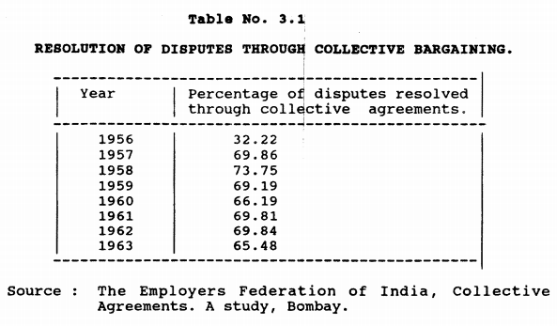
66
RESOLUTION OF DISPUTE
The growth of collective bargaining immediately after Independence can be judged from a study of the collective agreements published in 1962 by the 'Employers' Federation of India‘
There were 114 agreements entered into during the period of eight years from 1954 to 1961
Notes:
I am working

Slide 67
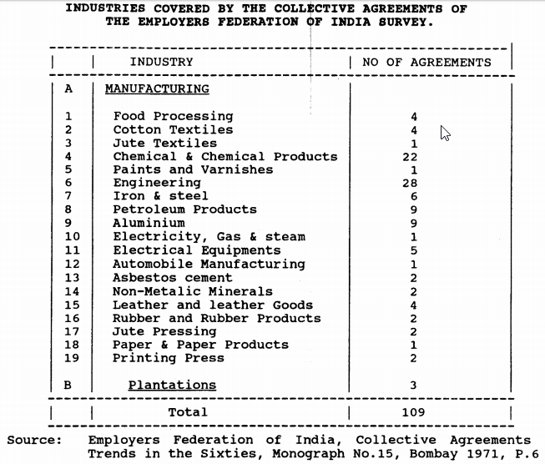
67
INDUSTRIES COVERED
The Employers Federation of India published another study in 1971 which showed that there were 109 agreements negotiated successfully
The survey also shows the spread of collective bargaining in different industries
Notes:
I am working

Slide 68
68
SEWA
Self Employed Women’s Association (SEWA). SEWA was established in 1972 and in 2012 had about 1.3 million members in over 14 districts in ten states of India
In 2001, about 441,100 people were employed in bidi making in India, bidi industry is unorganized (informal) sector
SEWA’s interventions in the bidi industry date back to 1978, and in 1981, the Bidi Workers’ Organization was established in Ahmedabad
In 1982, SEWA organized a general meeting of 5,000 bidi workers, with the then Finance Minister of Gujarat State attending
In 1983, SEWA submitted a report of this meeting to the state government. As a result, the government increased the price paid by factory owners to workers for bidis
SEWA workers then established a cooperative society. The members of the cooperative submitted a memorandum to the Labour Commissioner of Gujarat State detailing their problems
Notes:
I am working

Slide 69
69
SEWA Cntd..
The State Labour Department had inspected the workplaces of the workers, the members’ demands were accepted, Identity cards were issued
A factory owner who had retrenched 200 bidi workers took them back and compensated the workers.
The factory owner also agreed to give them provident fund benefits
SEWA organizers assisted the bidi workers throughout the discussions with the Gujrat PF fund commissioner
After the joint meeting, provident fund payments of 497,790 rupees were made to 191 bidi worker
SEWA perceives government agencies and government schemes as providing a good base for collective bargaining.
Notes:
I am working

Slide 70
70
THANKS!
Any questions?
You can find me at mcs192567@iitd.ac.in

Slide 71
71
REFERENCES
https://www.ica.coop/en/cooperatives/what-is-a-cooperative
https://en.wikipedia.org/wiki/Amazon_Mechanical_Turk
https://fthats.wordpress.com/2012/02/03/communal-spirit-cooperative-vs-collective/
https://cooperativesfirst.com/blog/2017/08/17/20178175-reasons-co-ops-can-fail/
https://cooperativesfirst.com/blog/2017/08/23/20178235-ways-co-ops-improve-economic-growth-in-rural-and-remote-communities/
http://crowdsourcing-class.org/readings/downloads/ethics/turkopticon.pdf
http://airilampinen.fi/files/CSCW%202018%20Coops%20camera-ready.pdf
Collective Bargaining and Collective Action: Labour Agency and Governance
https://www.researchgate.net/publication/298096040_Collective_bargaining

